Slide 1
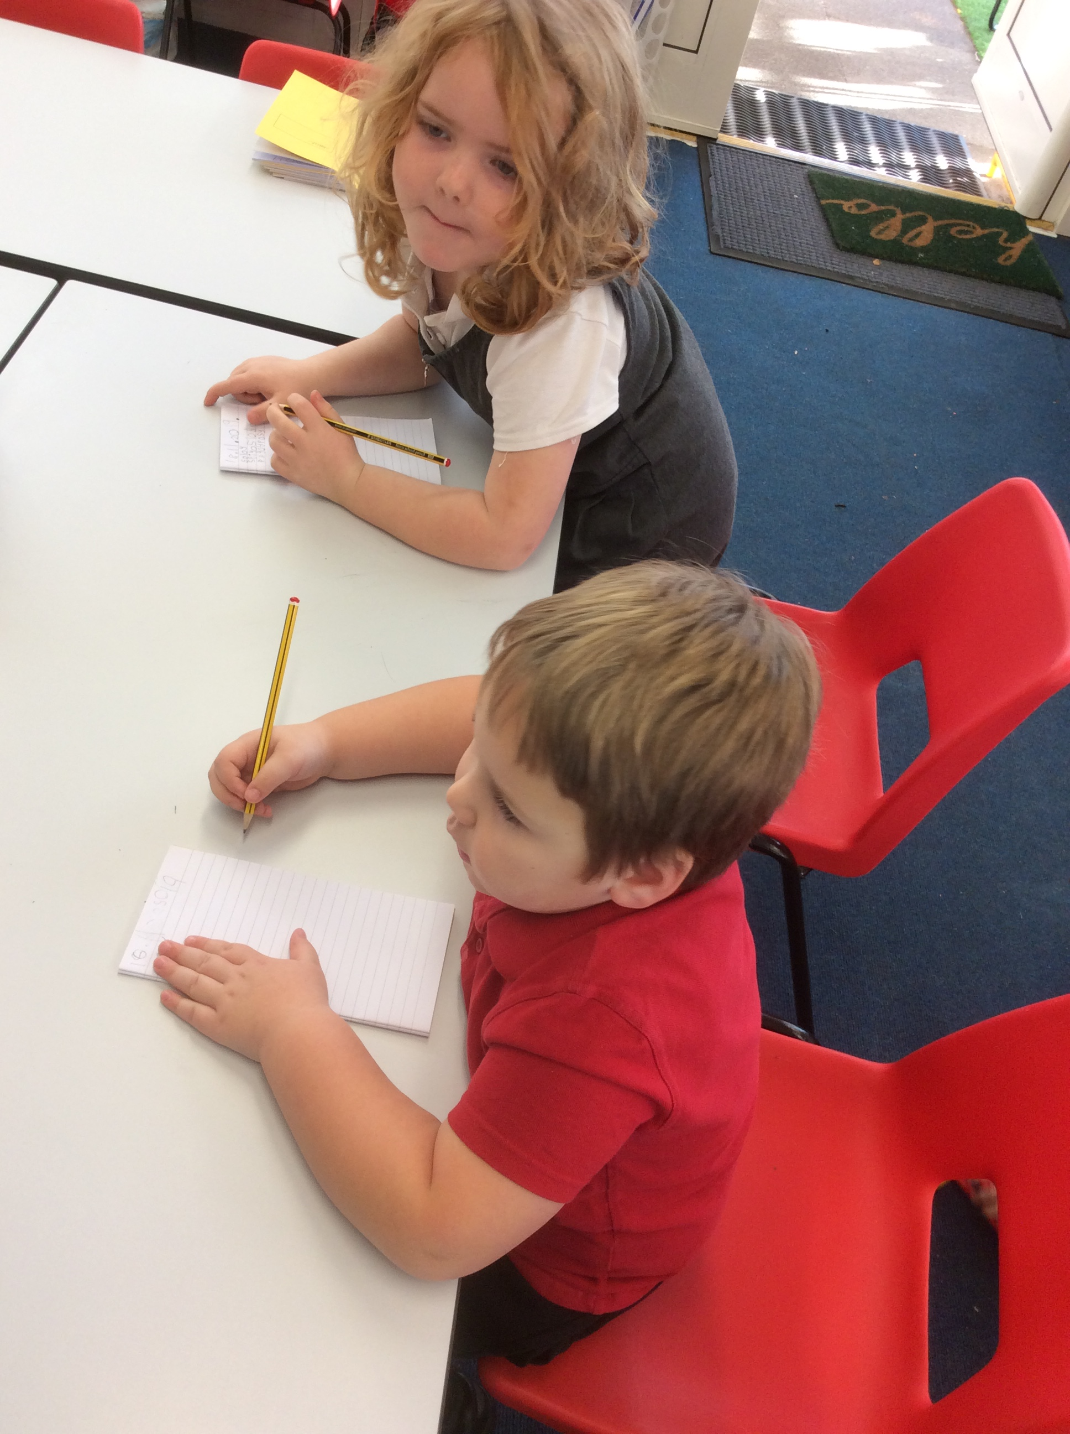
Worthington Primary School
Open Morning

Slide 2
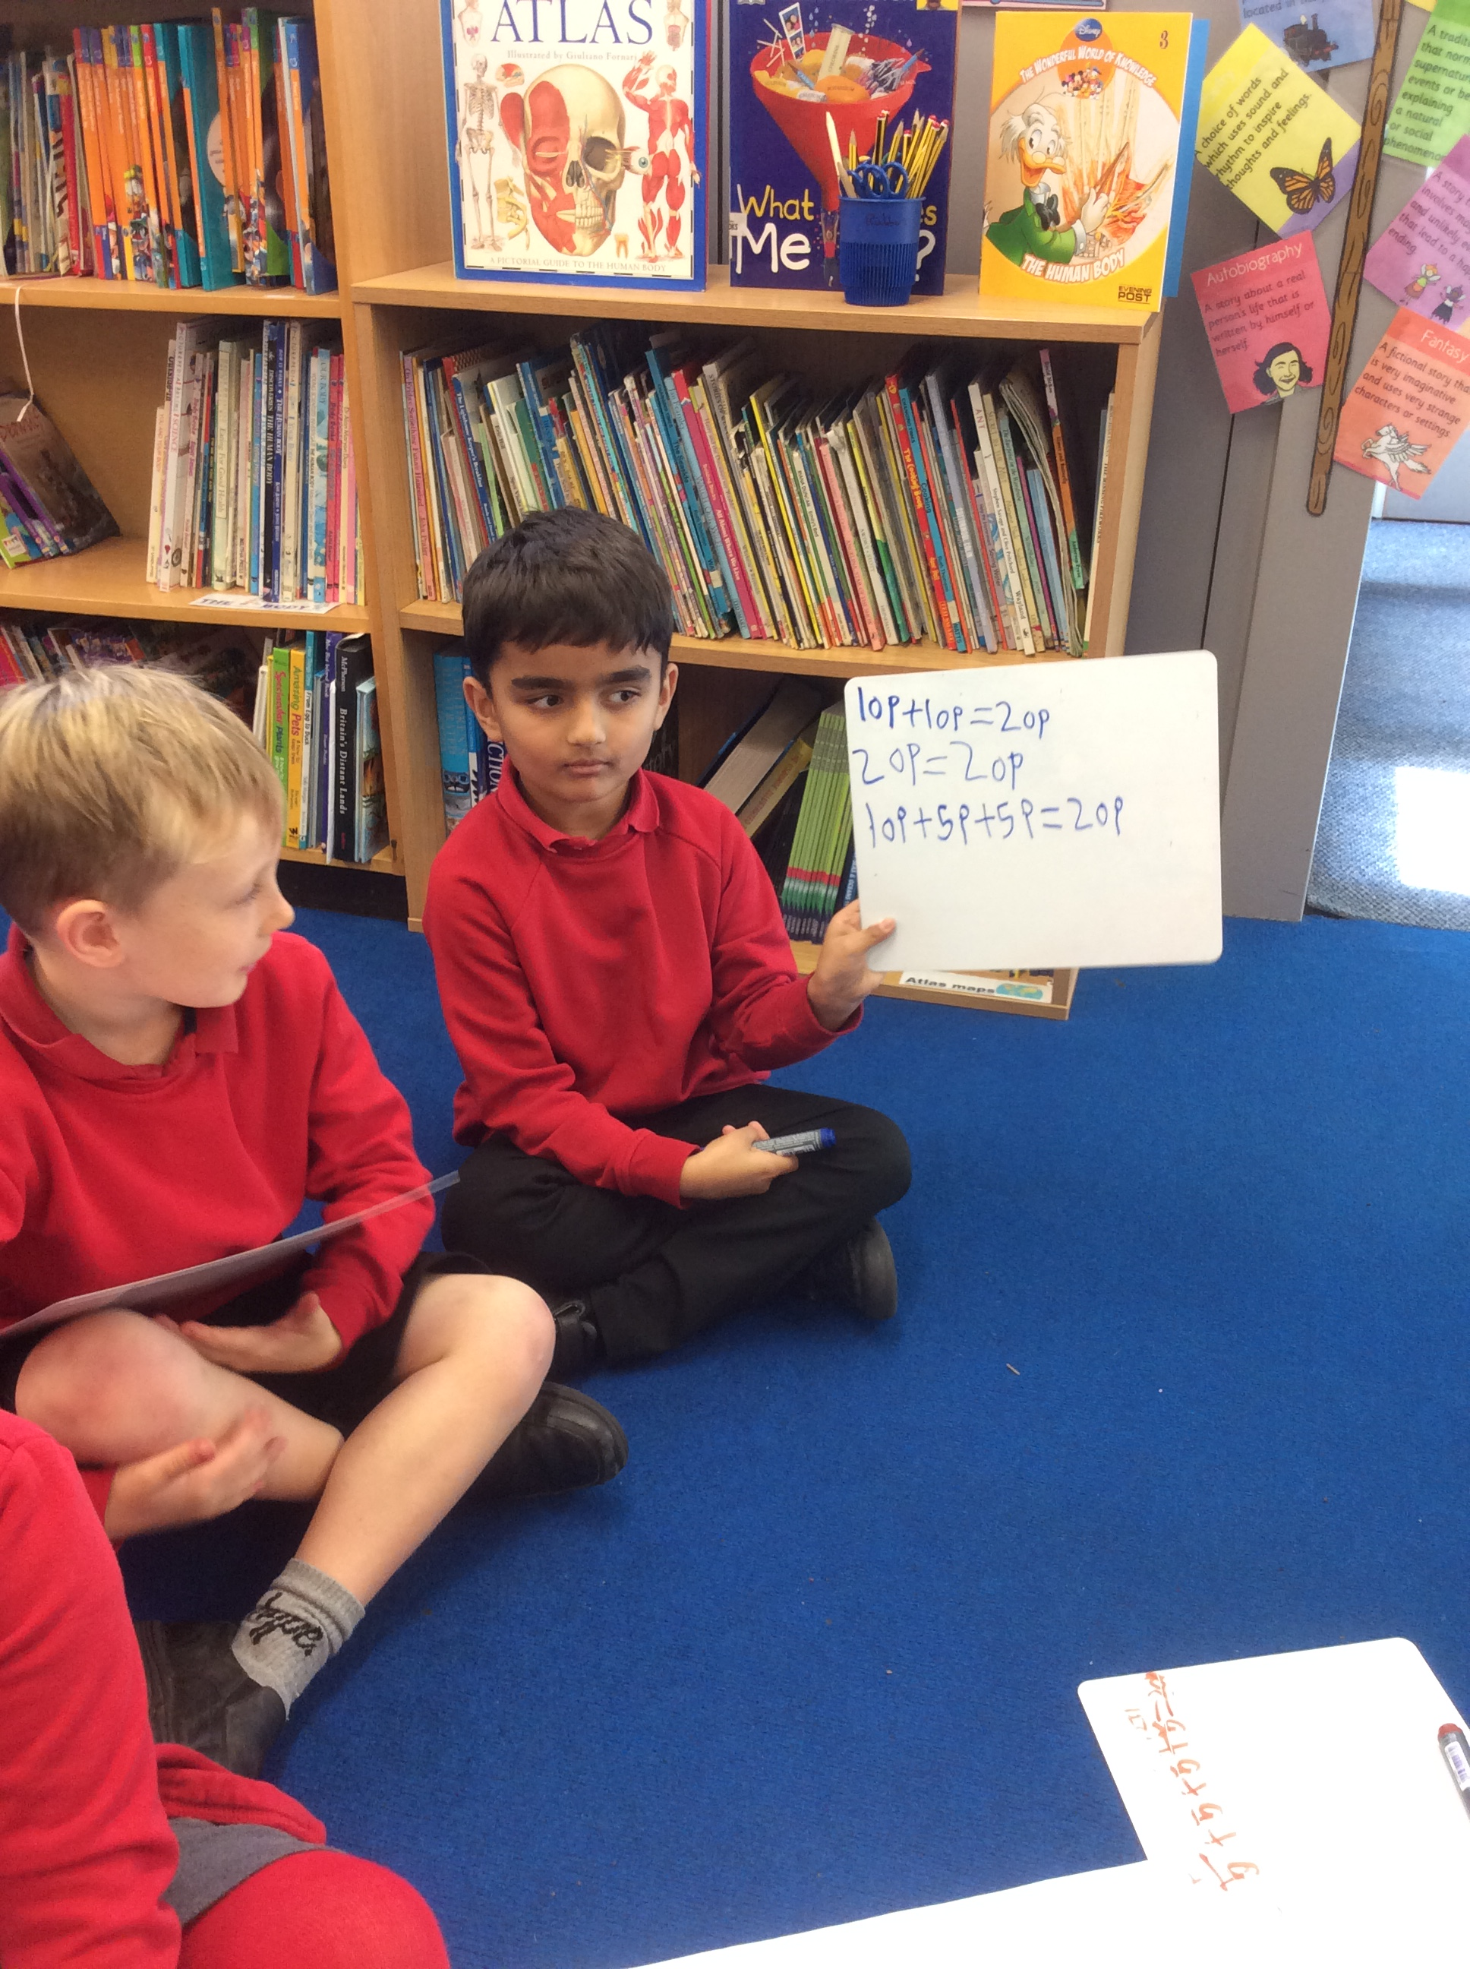
Welcome

Slide 3
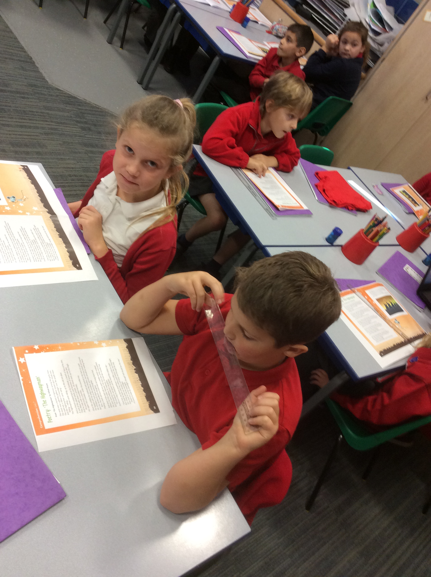
All about us
Worthington Primary School, an ‘Outstanding’ School, is a rural village primary school at the heart of its community in Worthington.
It draws approximately 67 children from Worthington and the locality as well as from further afield.
Children benefit from the education offered by Mrs Clark (Headteacher) and my team of dedicated teaching staff and teaching assistants maintaining a strong family atmosphere and culture of success.
We are able to offer extended provision on our school site with our own breakfast club and after school clubs.

Slide 4
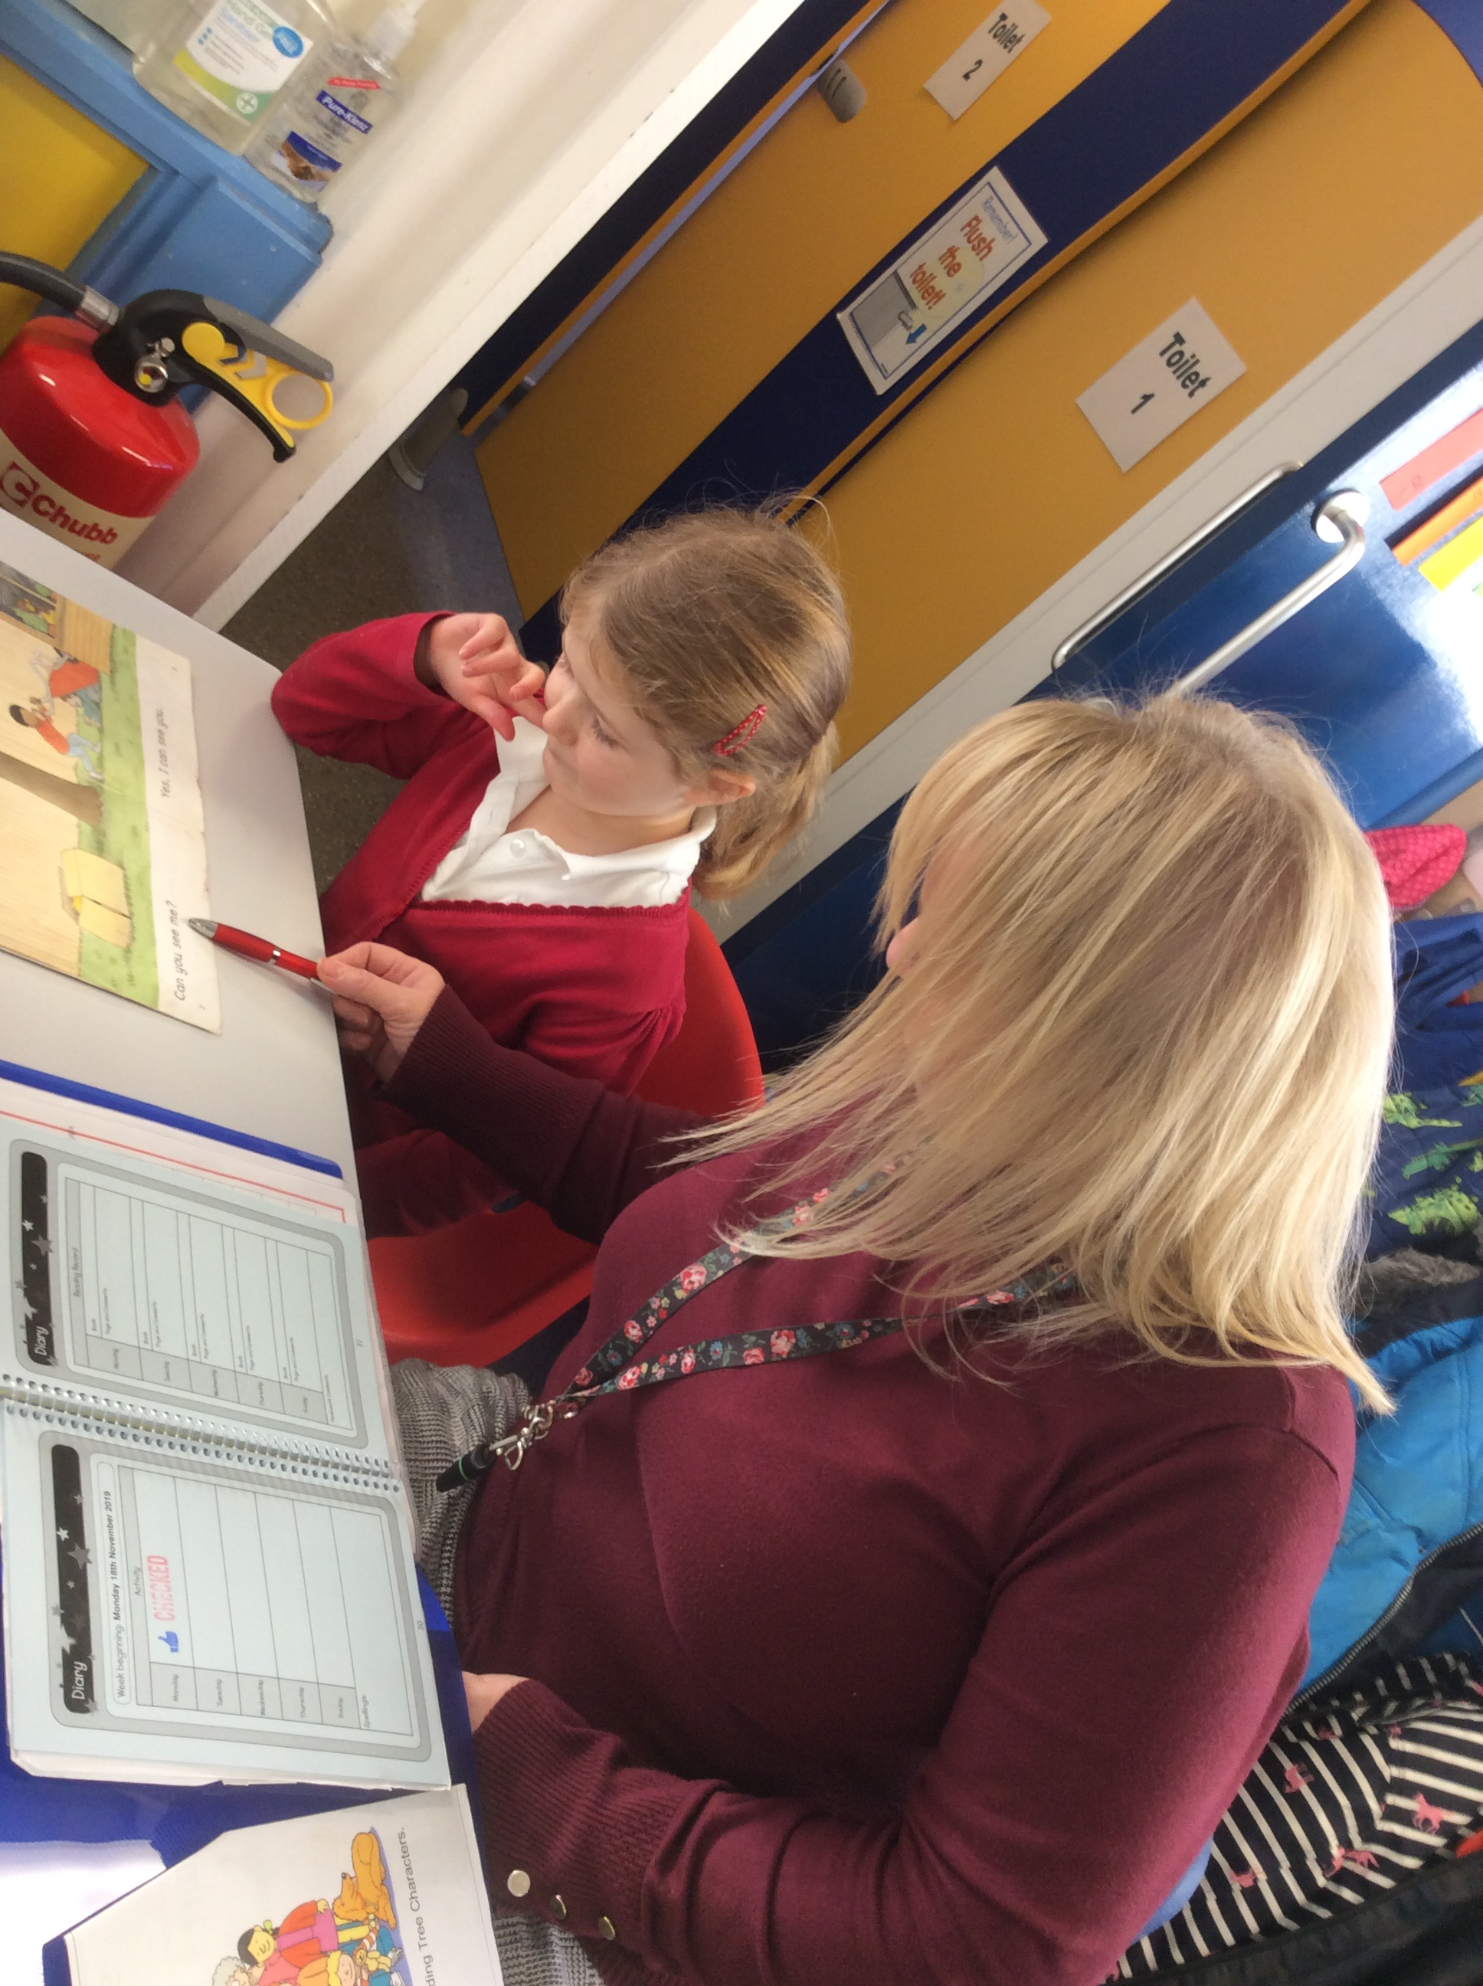
All about us
Over the years our school has grown, developed, improved and modernized in many ways.
The school was opened on 31st August 1926 with 49 pupils.
We were very lucky to have a new classroom built in 2014.
A new office and entrance hall was modernised in 2015.
New boys toilets in September 2021
We continually look at how we can update and improve the school.
Classrooms have been decorated
Worthington retains its small friendly, family feel whilst providing a learning environment and community facilities that are bright, fresh and ‘state of the art’.
Outside we have our own play area including an adventure playground and an area of astro turf.

Slide 5
Mission Statement
‘Opportunity and achievement for all’

Slide 6
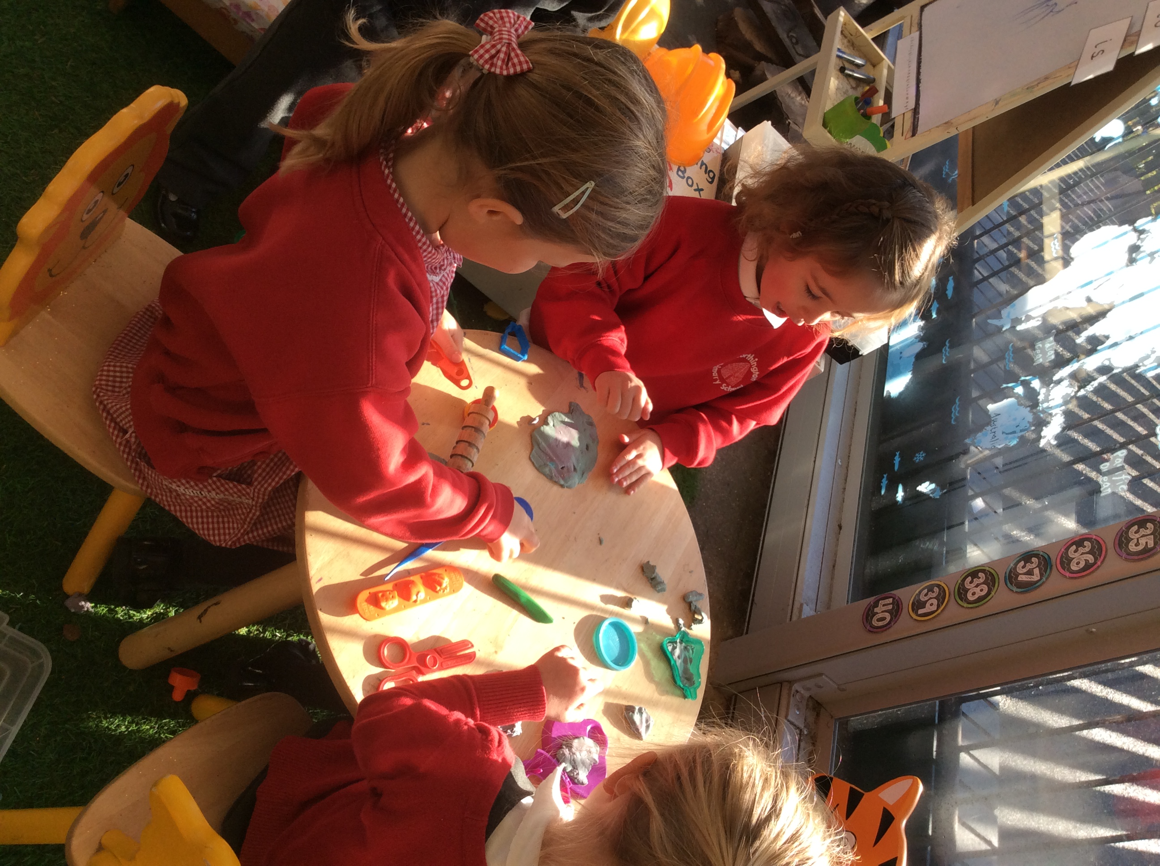
Awards and Achievements
Ofsted Outstanding (2012/13)
Healthy School +
School Games Mark – Gold
Route to Resilience
Working towards Dyslexia Friendly school
Music Mark

Slide 7
Organisation
As a small school we have the advantage of teaching our pupils in small mixed year group classes. The school is currently organised into three classes.
Class 1 – Reception, Year 1 and Year 2
Class 2 – Year 3 and 4
Class 3 – Year 5 and 6
We have 3 class teachers, 1 nursery nurse, 1 teaching assistant and 1 HLTA and 2 LSA.
Volunteer helpers, governors and students also visit on a regular basis to support pupils in their learning.
We have a specialist music teacher, a French teacher and a specialist PE teacher.

Slide 8
The school day
7:30 – 8:50 Breakfast club in the hall
8.50 Gates are opened and staff on duty to greet the children
9:00 – 9:10 Registration
9:10 – 9:30 Phonics
9:30 – 10:40 Lesson 1 English
10:40 – 11:00 Playtime
11:00 – 12:00/10 Lesson 2 Maths
12:00 – 1:00 Lunch time
1:00 – 1.30 Assembly (Mon, Wed, Fri)
1:10 – 3:20 Lesson – (Art, History, Geography, PE, French etc)
Playtime
Children in KS1 are offered a piece of fruit at morning playtime; this is provided free of charge. Children may bring a snack for morning break (healthy snack)
Each child needs a water bottle.
Children in KS1 also have a free dinner.

Slide 9
The school day
Lunch Times
Children can have a school lunch or they may bring a packed lunch. School lunches are free for all of KS1 and are freshly prepared on the school site.
We often have themed lunch days which the children enjoy!
If your child has a packed lunch, then because we are a healthy school we try to encourage a healthy packed lunch, so no sweets or chocolate bars or fizzy drinks.
End of the day
Class 1 – Children collected from the playground
Class 2 – Children come out from the side door and collected outside the classroom
Class 3 – Children collected from the playground

Slide 10
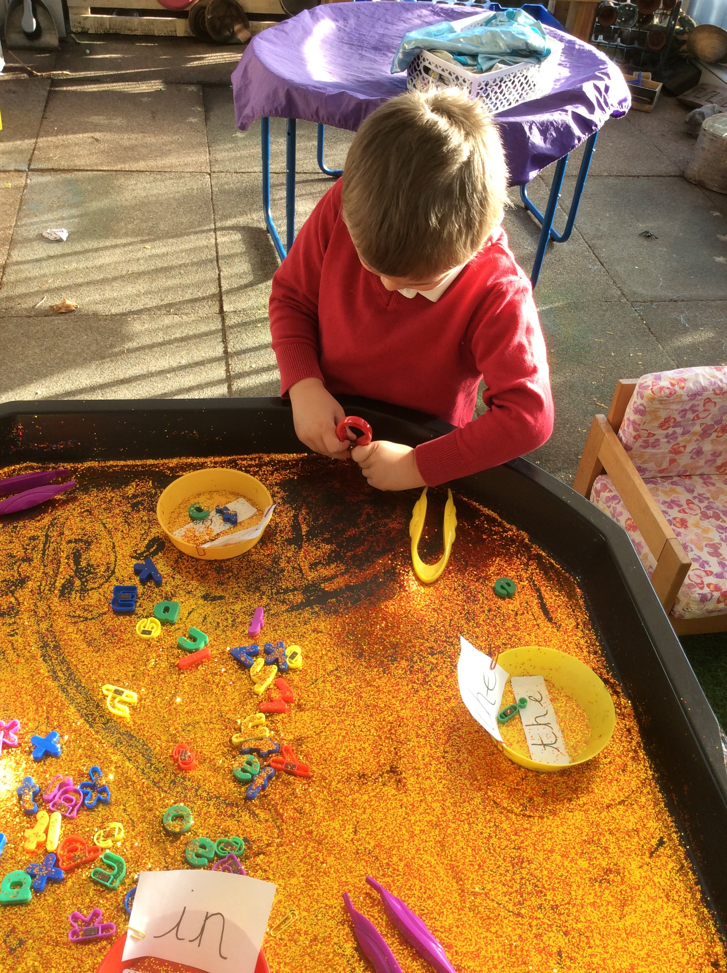
Partnerships
Unity
Small schools Network
Ashby Collaborative Group
FWTSA
Leicestershire and Rutland Teaching School Hub.
Local schools
NWLSSP
Youth sports trust
Church
Local Pub

Slide 11
Working with parents and families
Monthly newsletter
Do-Jo (Rewards)
Weduc App
Facebook / twitter
Email
Text Service
Parent noticeboard
Website
PTFA
Governors

Slide 12
Our Curriculum and beyond
Worthington Primary School provides a full, broad, balanced and creative curriculum which offers a wide range of opportunities to all pupils so they may develop to their full potential.
Children acquire skills through activities which are imaginative, creative, stimulating, varied and enjoyable set in an atmosphere of industry and purposefulness.
It is carefully planned to ensure progressive coverage of all subjects and the skills needed to succeed in that subject. We have a creative curriculum with lessons and series of lessons which are thematic as well as subject approaches as considered relevant, these themes are whole school and sometimes begin with a ‘hook’/ exciting stimuli such as a visit or visitor or event.

Slide 13
The Foundation Stage
Reception Year

Slide 14
Key Stage 1 and 2

Slide 15
Special Educational Needs

Slide 16
Homework

Slide 17
Behaviour and Discipline

Slide 18
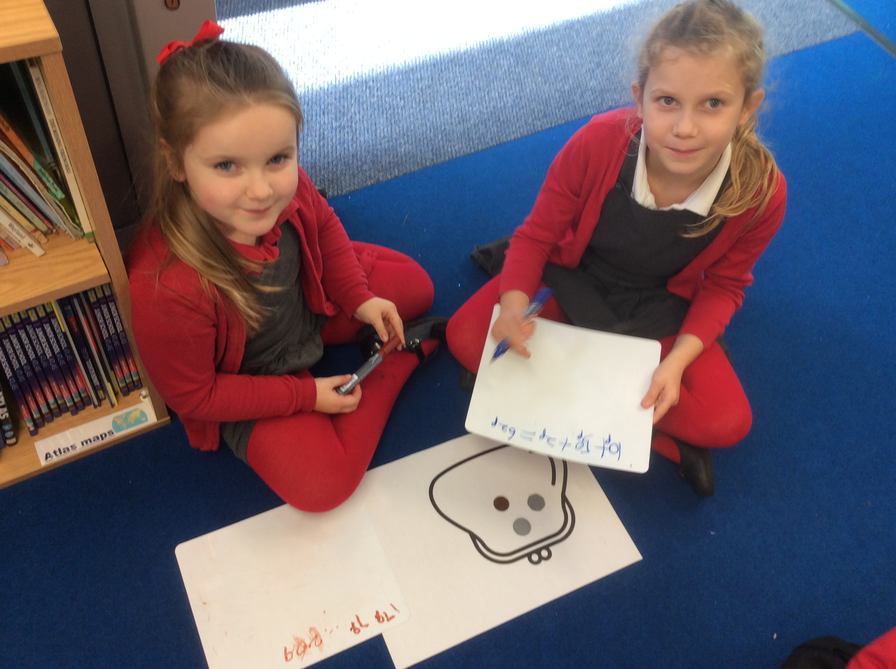
Uniform
Uniform Policy
Red jumper/cardigan
Grey/Black skirt/trousers
White/Red shirt/Polo shirt
Black shoes
No make up or jewellery
PE Kit

Slide 19
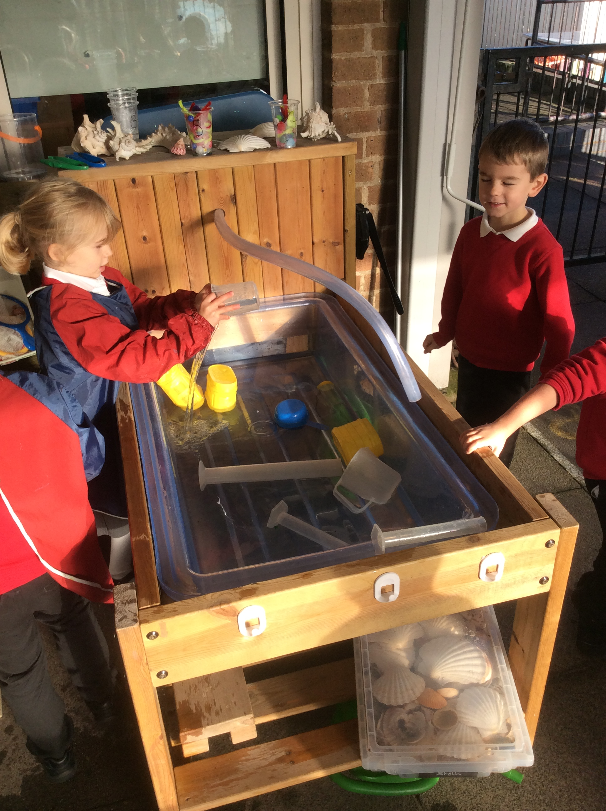
Thank You!
Any questions

